Slide 2


Slide 5


Slide 6


Slide 8


Slide 9


Slide 10


Slide 11


Slide 12


Slide 13


Slide 14


Slide 15


Slide 16


Slide 17


Slide 18


Slide 19


Slide 20


Slide 21


Slide 22
NBA Team Sponsors

Slide 23
$57 billion industry
NBA Team Sponsors

Slide 24
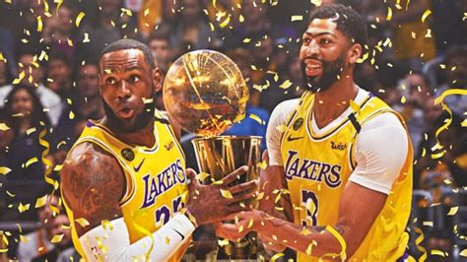
2020 NBA Champions

Slide 25
2020 NBA Champions

Slide 26
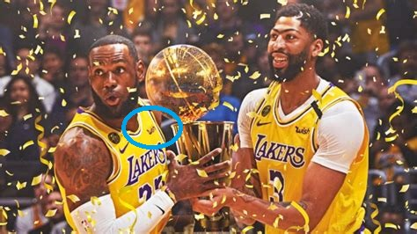
2020 NBA Champions

Slide 27
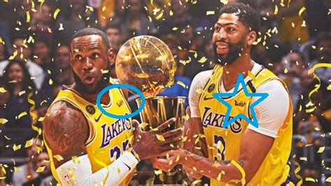
2020 NBA Champions

Slide 28
Sponsor a winner

Slide 29
Sponsor a winner
Get more air time

Slide 30
Forecasting Game Outcomes

Slide 31
Data Wrangling

Slide 32
Data Wrangling
Kaggle Dataset with NBA Games from 2004 - 2020
https://www.kaggle.com/nathanlauga/nba-games

Slide 33
Data Wrangling
Kaggle Dataset with NBA Games from 2004 - 2020
https://www.kaggle.com/nathanlauga/nba-games
Null and missing values

Slide 34
Data Wrangling
Kaggle Dataset with NBA Games from 2004 - 2020
https://www.kaggle.com/nathanlauga/nba-games
Null and missing values
Transform individual games into “On this day”

Slide 35
Data Wrangling
Kaggle Dataset with NBA Games from 2004 - 2020
https://www.kaggle.com/nathanlauga/nba-games
Null and missing values
Transform individual games into “On this day”
23,096 x 31 dataset size

Slide 36
Data Wrangling
Kaggle Dataset with NBA Games from 2004 - 2020
https://www.kaggle.com/nathanlauga/nba-games
Null and missing values
Transform individual games into “On this day”
23,096 x 31 dataset size
Bayesian priors for early season winning percentage

Slide 37
EDA: Define data relationships

Slide 38
EDA: Define data relationships
*warning: it’s about to be bright

Slide 39
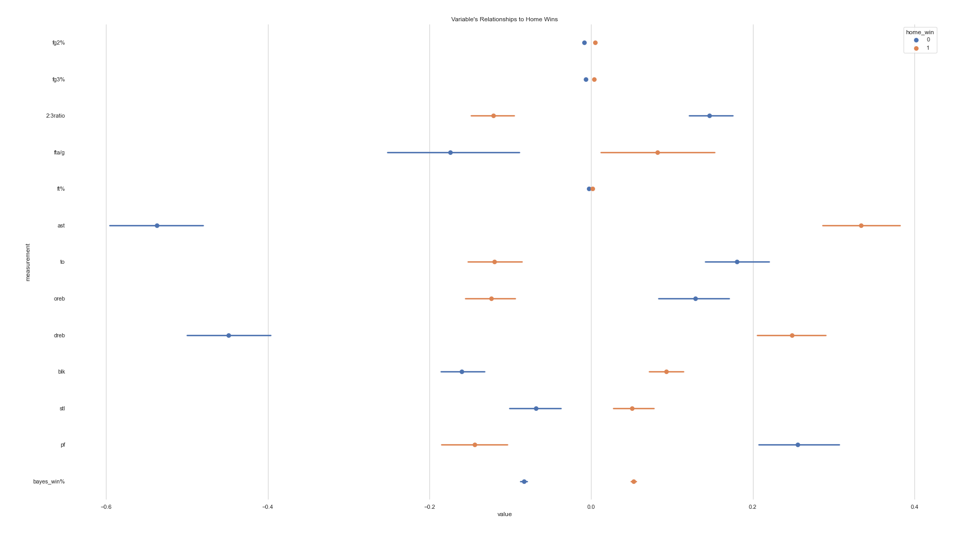

Slide 40
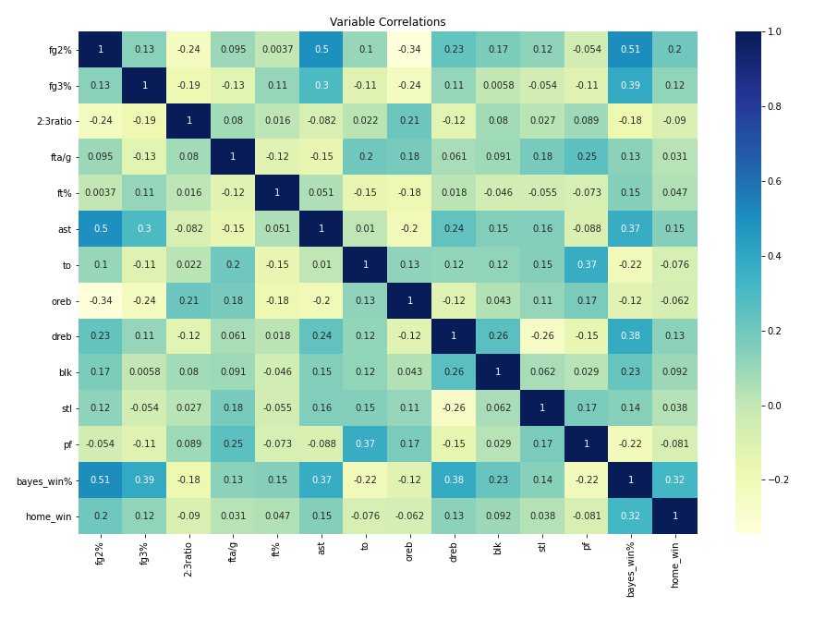
EDA: Define data relationships

Slide 41
EDA: Define data relationships
Lots of potential predictive features

Slide 42
Processing, Model Selection
TrainTestSplit (20% Hold Out Test Set)

Slide 43
Processing, Model Selection
TrainTestSplit (20% Hold Out Test Set)
After initial exploration of 13 classifiers, narrowed to 3 classifiers

Slide 44
Processing, Model Selection
TrainTestSplit (20% Hold Out Test Set)
After initial exploration of 13 classifiers, narrowed to 3 classifiers
Logistic Regression

Slide 45
Processing, Model Selection
TrainTestSplit (20% Hold Out Test Set)
After initial exploration of 13 classifiers, narrowed to 3 classifiers
Logistic Regression
Deep Neural Network

Slide 46
Processing, Model Selection
TrainTestSplit (20% Hold Out Test Set)
After initial exploration of 13 classifiers, narrowed to 3 classifiers
Logistic Regression
Deep Neural Network
Gradient Boosting Classifier

Slide 47
Processing, Model Selection
TrainTestSplit (20% Hold Out Test Set)
After initial exploration of 13 classifiers, narrowed to 3 classifiers
Logistic Regression
Deep Neural Network
Gradient Boosting Classifier
(+ Voting Classifiers)

Slide 48
Processing, Model Selection
Checked AUROC (5-fold CV) for tuning

Slide 49
Processing, Model Selection
Checked AUROC (5-fold CV) for tuning
GradientBoostingClassifier best performing

Slide 50
Processing, Model Selection
Checked AUROC (5-fold CV) for tuning
GradientBoostingClassifier best performing
Differences *very* slight

Slide 51
Processing, Model Selection
Checked AUROC (5-fold CV) for tuning
GradientBoostingClassifier best performing
Differences *very* slight
Model | AUROC | Accuracy
Logistic Regression | 0.612 | 0.648
Neural Network | 0.607 | 0.648
Gradient Boosting Classifier | 0.621 | 0.65
Soft Voting | 0.619 | 0.651
Hard Voting | 0.63 | 0.647

Slide 52
Processing, Model Selection
Checked AUROC (5-fold CV) for tuning
GradientBoostingClassifier best performing
Differences *very* slight
Model | AUROC | Accuracy
Logistic Regression | 0.612 | 0.648
Neural Network | 0.607 | 0.648
Gradient Boosting Classifier | 0.621 | 0.65
Soft Voting | 0.619 | 0.651
Hard Voting | 0.63 | 0.647

Slide 53
Hyperparameter Tuning
RandomSearch
HyperOpt
GridSearch (narrowed)
Final Model:
GradientBoostingClassifier(loss='exponential', n_estimators=250, min_samples_split=5, min_samples_leaf=4, max_features=8)

Slide 54
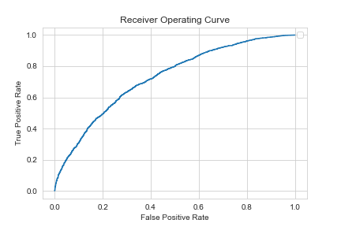
Model Performance

Slide 55
Model Performance
 |  | Actual
Predicted | Home Loss | TN = 13% | FP = 27%
 | Home Win | FN = 18% | TP = 42%
 |  | Home Loss | Home Win

Slide 56
Business Insights

Slide 57
Business Insights
Use these recs

Slide 58
Business Insights
Use these recs
Deeper understanding of team abilities

Slide 59
Business Insights
Use these recs
Deeper understanding of team abilities
Feature relationships to reveal basketball insights

Slide 60
Future Work

Slide 61
Future Work
More detailed data (pre-2004?)

Slide 62
Future Work
More detailed data (pre-2004?)
Build pipeline for full season simulations

Slide 63
Future Work
More detailed data (pre-2004?)
Build pipeline for full season simulations
Check performance against unseen data (backtesting, 2020-2021 season)

Slide 64
Appendix
This capstone project was completed for the Springboard Data Science Career Track.
The intended hypothetical audience for this presentation is the executive board of a company looking to sponsor an NBA team’s uniforms.
The main goal was to project the outcomes of individual NBA games.
The Github repository for this project can be found here: https://github.com/abewoycke/NBA-Projections

